Slide 1

Depth Study One – Tourism
Using fieldwork and/or secondary sources students investigate the reasons for, and consequences of, the changing spatial distribution of production and consumption (and, where appropriate, reuse) of tourism – business, eco-tourism or recreational.

Slide 2
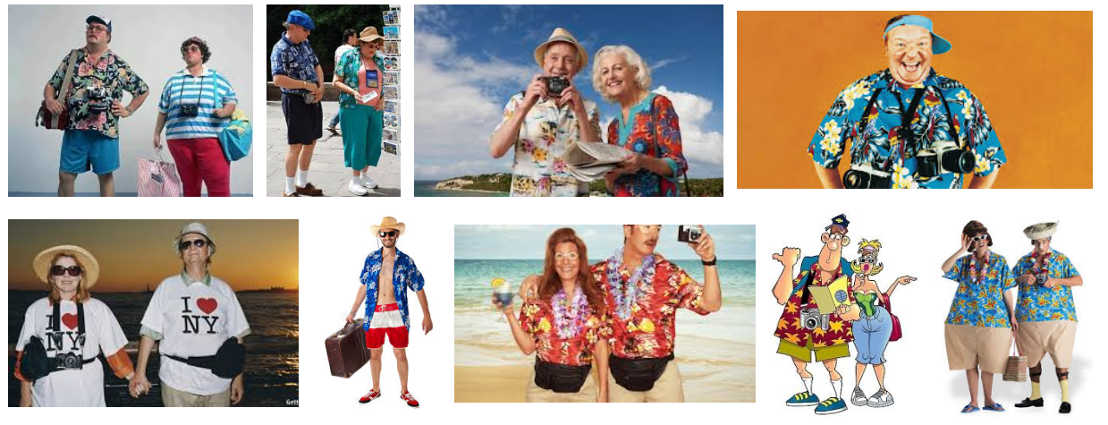

Slide 3
And that’s the wonder thing about family travel: it provides you with experiences that will remain locked forever in the scar tissue of your mind. – Dave Barry (US Author)

Slide 4
The world is a book, and those who do not travel read only a page. – St Augustine, Thoelogian

Slide 5
Like all great travellers, I have seen more than I remember, and remember more than I have seen. – Benjamin Disraeli, English Statesman and literary figure.

Slide 6
1.
The nature of the commodity, good or service (Tourism).
Syllabus Point.

Slide 7
What does NATURE refer to?

Slide 8
Tourism
Temporary movement of people travelling together outside their normal place of work and residence.

Slide 9
Global Tourism - History
For 1,000s of years humans have responded to the urge to discover the unknown, to explore strange new places, to seek new experiences and see new surroundings.
Annual migration began more than 100 years ago, but the present day exodus, especially international tourism, is essentially a post WW2 phenomenon.
Tourism is a luxury.
Until recently participation was restricted to those who could afford the time and the money to travel.
Today most people in the developed world and increasing numbers of people in developing countries engage in tourism at some time in their lives.

Slide 10

Handout: The Nature of Tourism

Slide 11
Activities
Distinguish between tourism and travel.
Describe how attitudes to tourism have changed. (Source 3.1.1 may help).
Explain why tourism is described as a ‘highly complex’ productive activity.
Outline the global importance of tourism as a productive activity.
Explain why it has been difficult to arrive at an adequate definition of tourism.
Define tourism.
List the characteristics of tourism.
Distinguish between international and domestic tourism.
Collect hand out “9.4 Tourism” – read and make summary notes from the chapter.

Slide 12
The process of diffusion of Tourism and its spatial outcomes.
Syllabus Point.

Slide 13
Diffusion
Diffusion, in the scope of geography, is the spread of people, things, ideas, cultural practices, disease, technology, weather, and more from place to place; thus, it's called spatial diffusion.

Slide 14
Example
Globalization is an example of spatial diffusion. Take, for example, products in a person's home. A woman's handbag may have been made in France, her computer in China. Her spouse's shoes may have come from Italy and car from Germany. Spatial diffusion has a clear origin point that it spreads from.

Slide 15
Expansion diffusion comes in two types, contagious and hierarchal.

Slide 16
i. Contagious Expansion
A contagious disease is a prime example. It knows no rules or boundaries as to where it spreads.
Other examples:
Bushfire
Social Media – memes and viral videos spread from person to person in contagious expansion diffusion as they are shared. “Going viral”
Religions spread through contagious diffusion as well, as people need to come in contact with the beliefs somehow to learn about them and adopt them.

Slide 17
ii. Hierachial Expansion
Hierarchal diffusion follows a chain of command, for example, in business or different levels of government.
the leader of a government body would likely know information before it is disseminated among the general public.
Fads and trends that start with one community before spreading to the wider public, such as hip-hop music starting in urban centres
Slang words starting with one particular age group before wider adoption—and then actually making it into the dictionary.

Slide 18
How can we apply diffusion to Tourism?

Slide 19
Spatial Diffusion
Tourism has developed in many different contexts. Modern mass tourism has its origins in the affluence of industrialised countries of western Europe, North America and, more recently Japan. Tourism has also expanded significantly in eastern Europe and is becoming an important sector in many developing countries in Asia, Africa, Latin America, the South Pacific and the Caribbean.

Slide 20
WAToday Survey
Q: What does Perth need the most?
Improved conference facilities
Inner-city general intake public primary and high schools
Facility shared by universities to bring students into CBD
Major central lyric theatre to host bigger, longer-running shows
Money-can’t buy event, exclusive and uniquely Perth (e.g. a festival)
Central and inner city recreation centres, with community spaces
A cultural facility “anchor” at Elizabeth Quay
Landmark exclusive unique tourism experience (e.g.. A cable car).

Slide 21
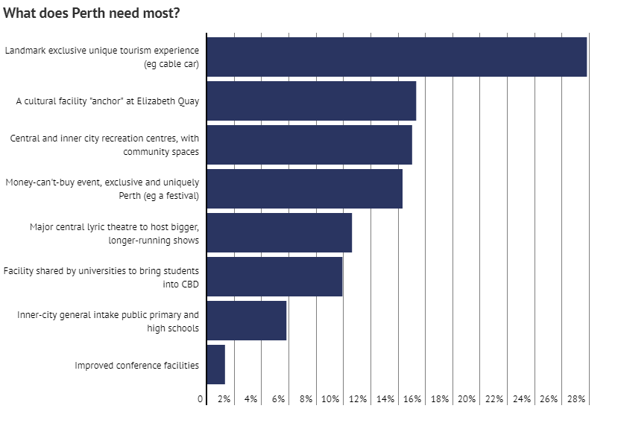

Slide 22


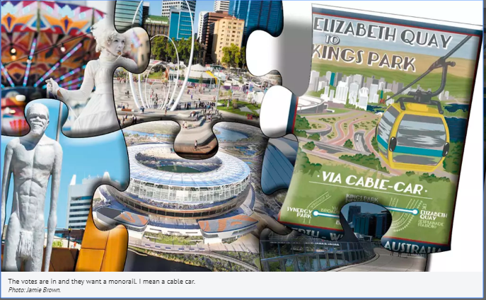
What's it called? Cable car! The Perth mob has spoken
By Emma Young 23 July 2018
The people of Perth have voted on how to jazz up the city both for residents and tourists: with a cable car between Kings Park and Elizabeth Quay the clear frontrunner.
More than 2000 people responded to a WAtoday survey containing the question “Which one does Perth’s CBD need most urgently?”
Most popular of the options by a country mile was “a landmark exclusive unique
tourism experience, e.g. Elizabeth Quay/South Perth/Kings Park cable car.”
The runner-up was a “cultural facility ‘anchor’ at Elizabeth Quay”, showing a clear desire from Perth punters to ‘activate’ the Quay.
In 2016, the Metropolitan Redevelopment Authority commissioned a preliminary study from a Swedish cable car consultant, showing a cable car would be both technically feasible and commercially viable without
government funding.
The Tourism Council of WA welcomed its conclusion that a cable car would provide 340 jobs and inject $30 million annually into the economy…
https://www.watoday.com.au/national/western-australia/what-s-it-called-cable-car-the-perth-mob-has-spoken-20180720-p4zsrc.html

Slide 23
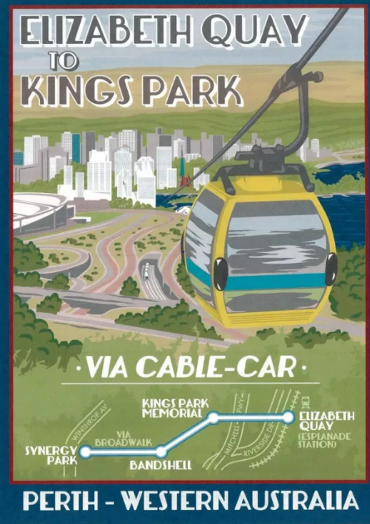
Perth cable car with $30m tourism boost potential back on the radar. By Emma Young 8th August 2018
The popular plan for a Perth Cable Car from Elizabeth Quay to King’s Park is back on the government’s radar, with West Australian Planning Minister Rita Saffioti signalling her intention to discuss it in cabinet.
Ms Saffioti told WAtoday this week she would speak with her ministerial colleagues regarding a formal response to the cable car report created during planning for Elizabeth Quay.
Potential cable car start points were identified in the Quay master plan and the Metropolitan Redevelopment Authority had hired a Swiss cable car consultancy to complete a “pre-feasibility” study.
The firm, which has worked on projects in North America, South America, Europe and Asia, provided a 190-page report in 2015 recommending four stations for the car, with three locations suggested for Kings Park stations, but the former government never actioned the next steps recommended in the report.

Slide 24
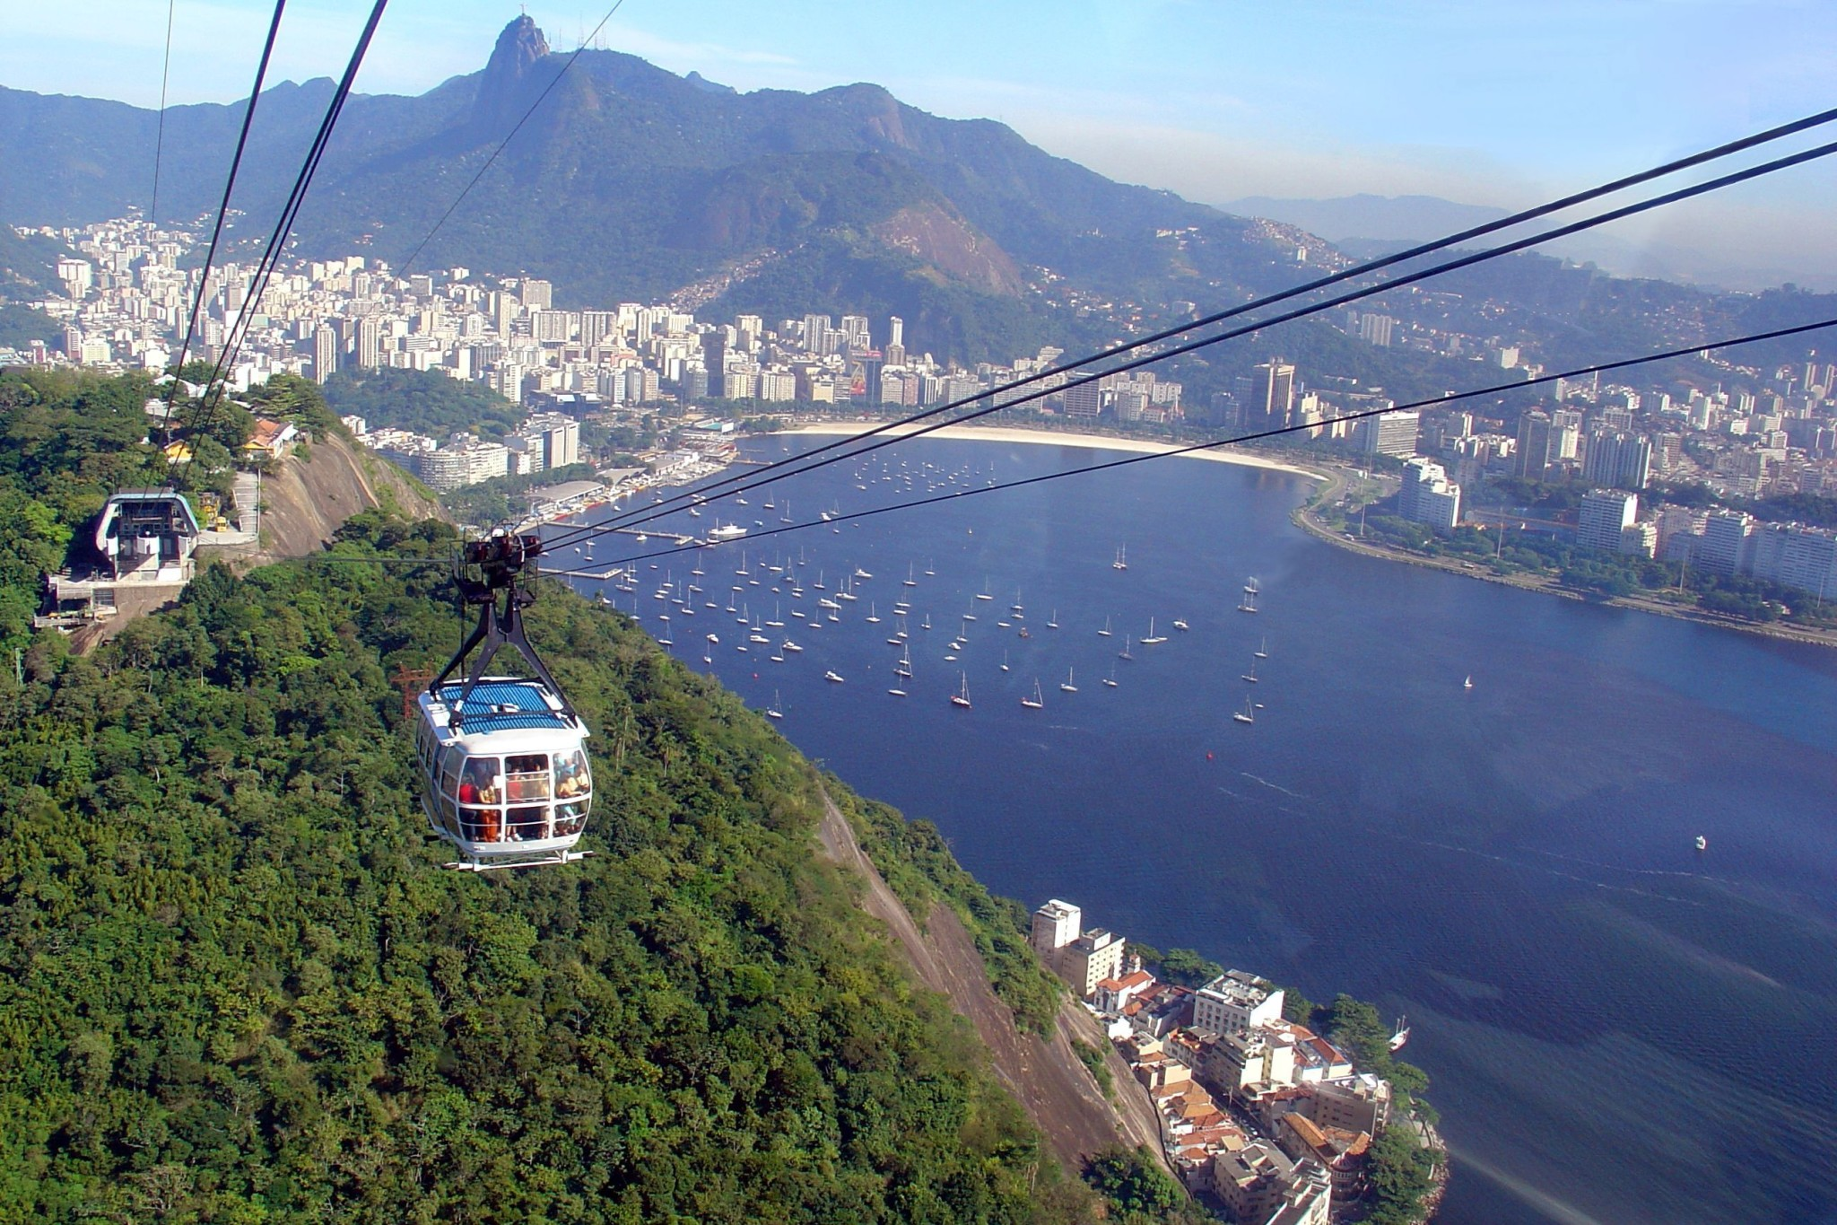
Sugar Loaf Cable Car
Rio De Janeiro

Slide 25
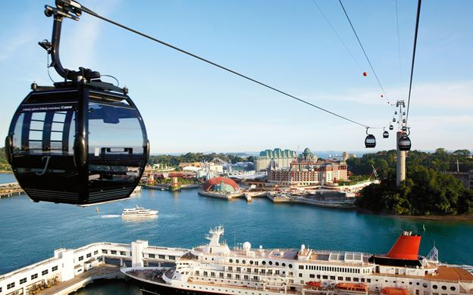
Singapore Cable Car
Sentosa Island

Slide 26
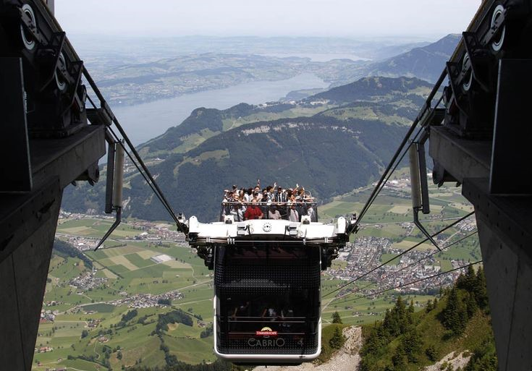
Stanserhorn
Switzerland
Notes:
https://www.youtube.com/watch?v=DDZfnZL8EG8

Slide 27
Diffusion?
The cable cars are the element being diffusion, they’re expanding from the origin – Europe, to other parts of the world for the tourism experience.

Slide 28
Homework: Think of other examples of diffusion related to Tourism?

Slide 29
The role played by technological advances in transport and/or telecommunications in facilitating these changes in the spatial distribution.
Syllabus Point.

Slide 30
List some examples of Transport Advancements and how they have impacted Tourism.
Passenger Aircraft – Boeing 737 and Air Bus
Bullet Trains
Cars
Motorcycle
Cable Car
Buses
Shorter travel times
Increased capacity
Caravans/RV
Cruise Ship
Helicopter
Trams

Slide 31
Technological Advances
One of the most important factors affecting tourism are technological advances.
Industrial technology was the prerequisite for tourism in the 19th century (steam power by rail and sea for mass tourism).
In the 20th century, transport technology for air, road and off-road vehicles allowed the spread of mass tourism and made destinations more widespread than those that could be reached by rail or ship.

Slide 32
Technological Advances
Competition amongst manufacturers is constantly developing the capabilities of vehicles in terms of their size, seat capacity, speed, range, fuel efficiency, noise level and passenger comfort.
Such developments affect the profitability of operations and can affect consumer choice.
Developments in transport will continue to determine which destinations can be reached within acceptable time and cost constraints.

Slide 33
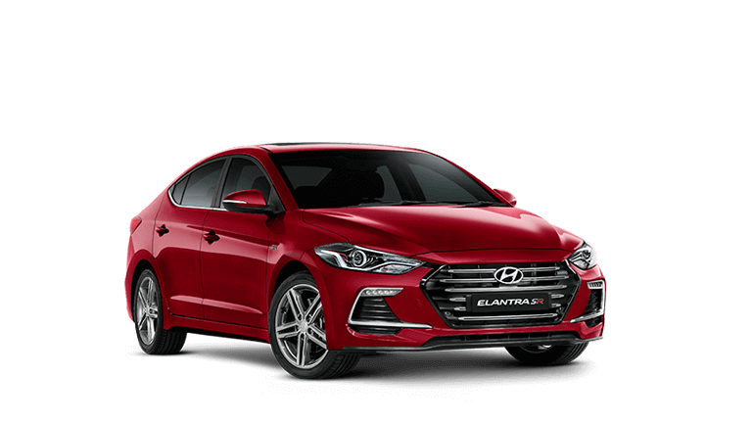
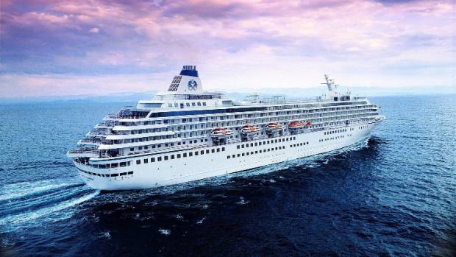
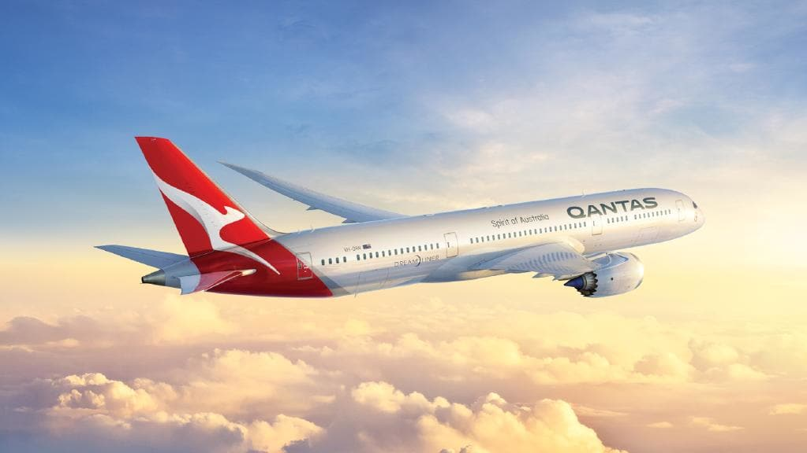
https://www.youtube.com/watch?v=NVItPJAu_Fk

Slide 34
How has advancements in Telecommunication Technology affected tourism?

Slide 35
Consumer Choice
The internet has greatly increased the amount of information available to tourists.
They can; view hotel facilities, make bookings, access websites to view attractions (museums, galleries, theme parks etc).
ICT allows people to ‘experience’ a place before they even leave home.

Slide 36
Unit 8.2 The Global Pattern of Tourism
Read the chapter pages 284 – 287
Complete activities Understanding the Test 1 – 4
Working Geographically 5 - 10

Slide 37
Handout: Technological Change
Read and take summary notes for each sub-heading:
Consumer choice
Aircraft
Land Transport
Sea Transport
Keeping Track of People and Possessions
EXTENSION: COMPLETE ACTIVITIES 2 and 3

Slide 38
The role played by governments and enterprises in the internationalisation of the production and consumption Tourism.
Syllabus Point.

Slide 39
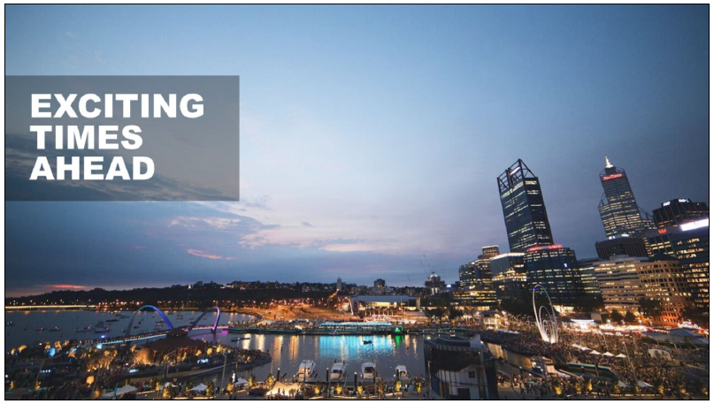

Slide 40
Tourism in Perth…
This is an exciting time to be in Perth which is undergoing a once in 100 year transformation. Unprecedented investment in public and private infrastructure includes:
Perth Airport and associated road networks
An explosion in the number of bars and restaurants opening
Redevelopment of the historic Treasury buildings
An additional 3,000 hotel rooms by 2019
The 60,200 seat Perth Stadium to open in 2018
Public spaces to link the CBD and Northbridge

Slide 41
Tourism in Perth…
A new museum
The recent opening and redevelopment of the new waterfront, Elizabeth Quay
Fremantle has more than a billion dollars of redevelopment in the planning pipeline including a new town centre and hotels
Scarborough beach is on its way to becoming one of Australia’s best beachfronts with a $60 million investment in a foreshore redevelopment including a beachside swimming pool, cafes, restaurants, kiosks and public art

Slide 42
Tourism in Perth…
Rottnest Island is also undergoing an improvement program with upgrades to the golf course and walk trails as well as a new marina. Luxury refurbishments of the Rottnest Lodge and Hotel Rottnest and an upmarket “glamping” experience.
Coupled with stellar events calendar for the city, all this presents a significant opportunity for new tourism products.

Slide 43
A critical industry for Western Australia
Tourism is a significant and growing contributor to WA’s economy
Tourism Industry generates 94,000 jobs or 7% of the State’s employment
In year ending March 2019 there were 9.4 million international visitors to WA.
International holiday visitor spend also reached a record high, growing 14.8% compared to the previous year to $808M, driven by an increase in visitors and average daily spend.
The State Government Strategy for Tourism is to increase the value of tourism in the state to $12 billion by 2020
Identified by Deloitte as one of five growth industries in Australia over the next few decades, alongside agribusiness, gas, international education and wealth management.

Slide 44
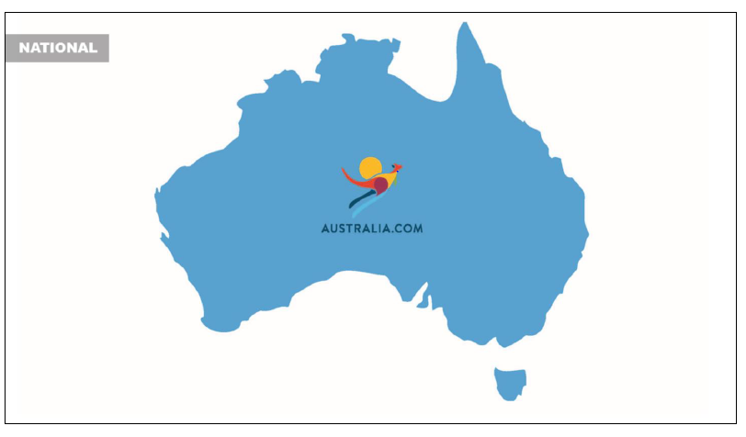

Slide 45
1. National Level
Tourism Australia
Australian government agency responsible for attracting international visitors to Australia, both for leisure and business events
Active in around 17 key markets
Activities include; advertising, PR and media programs, trade shows and industry programs, consumer promotions, online communications and consumer research

Slide 46
1. National Level
Austrade
Australian Government agency responsible for tourism policy, projects, programs and research to strengthen Australia’s tourism industry and grow Australia’s tourism market share.

Slide 47
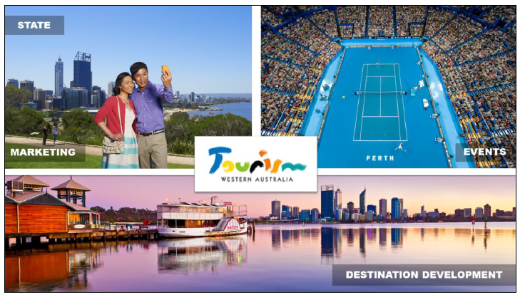

Slide 48
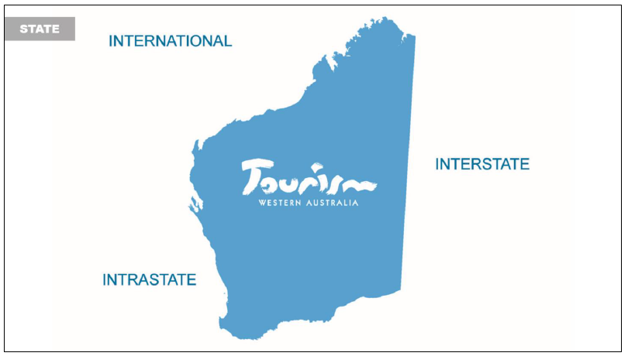

Slide 49
2. State Level
Tourism WA – Role
State government agency responsible for promoting Western Australia as an extraordinary holiday and business event destination
First and foremost an economic development agency responsible for getting the conditions right so the tourism industry in WA can thrive
Tourism WA is a State Government statutory authority and part of the broader economic development portfolio of Jobs, Tourism, Science and Innovation.
The agency works in partnership with industry, private sector and government to develop and promote WA’s iconic tourism experiences, to attract events to the State and to help the tourism industry thrive.

Slide 50
2. State Level
DEMAND
Marketing the state
Developing, attracting and promoting major sports, arts, cultural and culinary events
SUPPLY
Helping to develop destinations to maximise their tourism potential. This can include looking at ways to improve an area’s visitors amenities and attractions and ensuring the State’s policies and regulations supports tourism development

Slide 51
2. State Level
Tourism WA works closely with other Government agencies (local, state and federal) to achieve good outcomes for tourism.
They provide funding to other organisations to carry out work on the State’s behalf such as Perth Convention Bureau (to encourage business events), Western Australia Aboriginal Tourism Operators Council (to promote Aboriginal Tourism)

Slide 52
Tourism WA’s Events Division
Responsible for identifying, developing and supporting world-class events that promote and enrich Western Australia
Events give visitors a reason to travel to WA and often provide priceless exposure in key domestic and international markets through media coverage and television broadcasts
The Events Division bids for major international events which will attract significant numbers of international and interstate visitors, have a positive economic impact for Western Australia, and showcase the State.

Slide 53
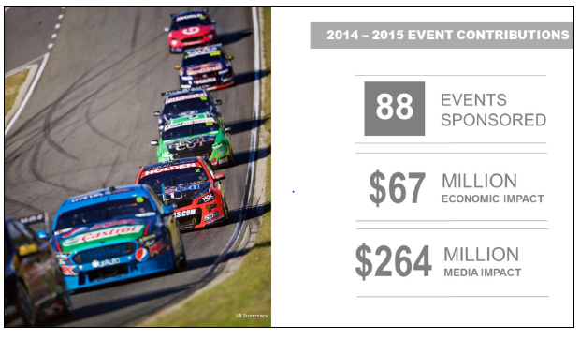

Slide 54
Events
Events provide a strong opportunity to grow and extend visitation:
They provide a definite, time-based reason to visit a particular destination
Events are equally attractive to visitors as well as local residents
Events activate infrastructure and energise the local community

Slide 55
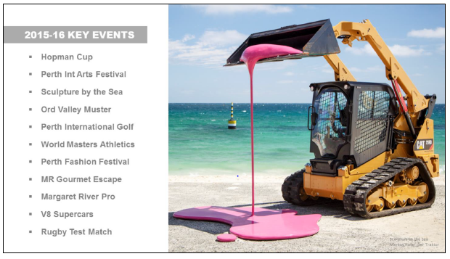

Slide 56
3. Regional Level
Western Australia is divided into 5 tourism regions. Each has its own regional tourism organisation – peak tourism marketing body for that region
Tourism WA provides significant financial support to each RTO to market the respective region. The majority of this activity is in the intrastate market and some interstate.
Tourism WA and the RTOs are in constant communication and work together on marketing and other strategies.
RTO for Perth = Experience Perth which represents tourism in this region.

Slide 57
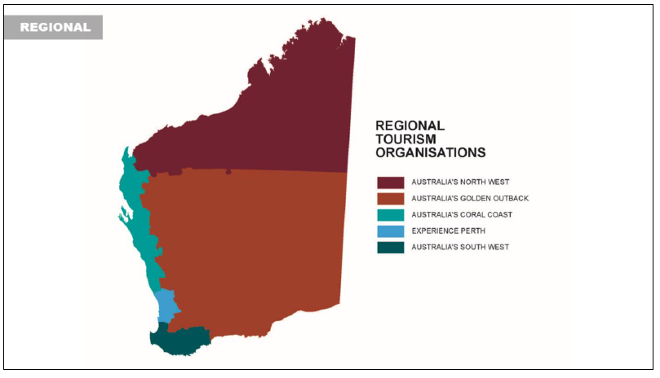

Slide 58
3. Regional Level
Regional Development Commissions
WA has 9 Regional Development Commissions – promote economic and social development of a particular part of the state.
Given the importance of tourism to regional economies, many development commissions work with stakeholders to develop a tourism strategy for their region.
Local Tourism Associations
Usually private sector, memberships-based bodies
Promote local tourism development initiatives

Slide 59
3. Regional Level
Local Government
Support tourism through economic development function
Many councils provide funding to Visitor Centres
Visitor Centres
Information for visitors to encourage them to stay longer, spend more money, experience more attractions and revisit a region

Slide 60
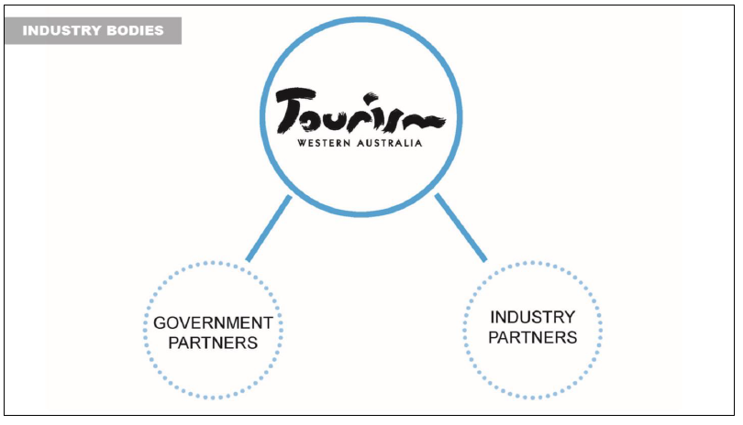

Slide 61
4. Industry Bodies
Several industry bodies and groups providing resources and opportunities to help tourism industry operators with day-to-day business activities
Tourism Council WA (TCWA)
Peak body representing tourism businesses, industries and regions in WA
TCWA offers a range of training courses, many of which are funded by Tourism WA, targeted at tourism businesses
Other key industry bodies include:
Australian Tourism Export Council
Australian Hotels Association WA
Visitor Centre Association of Western Australia
Caravan Industry Association WA

Slide 62
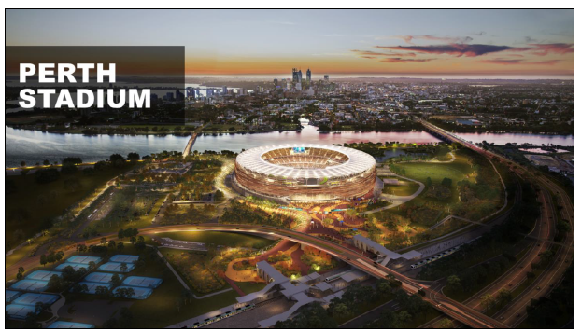

Slide 63
Optus Stadium
Opened early 2018 – Australia vs. England International One Day Match
A new tourism asset for the State, significantly boosting Perth’s ability to host major sporting events, concerts and stadium “spectaculars” thereby attracting more visitors
65,000 additional visitors per year projected, spending an extra $112m+ each year

Slide 64
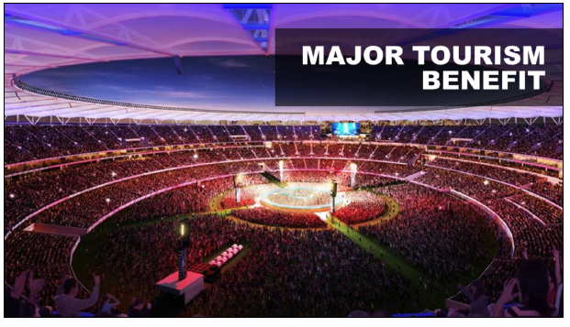

Slide 65
Optus Stadium
The stadium will have the ability to drive significant attendance and visitation to the state
Flexible format venue – AFL, soccer, rugby, athletics, large scale concert events
We will be able to attract sports and international events that Perth has never had the ability to stage due to lack of a world class stadium
There will be guaranteed ticket access for intrastate and interstate visitors

Slide 66
Kings Park and Botanic Garden
At 400 hectares, Kings Park is one of the world’s largest inner-city parks. After a short walk or bus ride from the central business district, you’ll be rewarded with superb views, rich Aboriginal and European history, more than 3,000 species of WA’s unique flora, restaurants and picturesque playgrounds and picnic spots.

